Slide 1


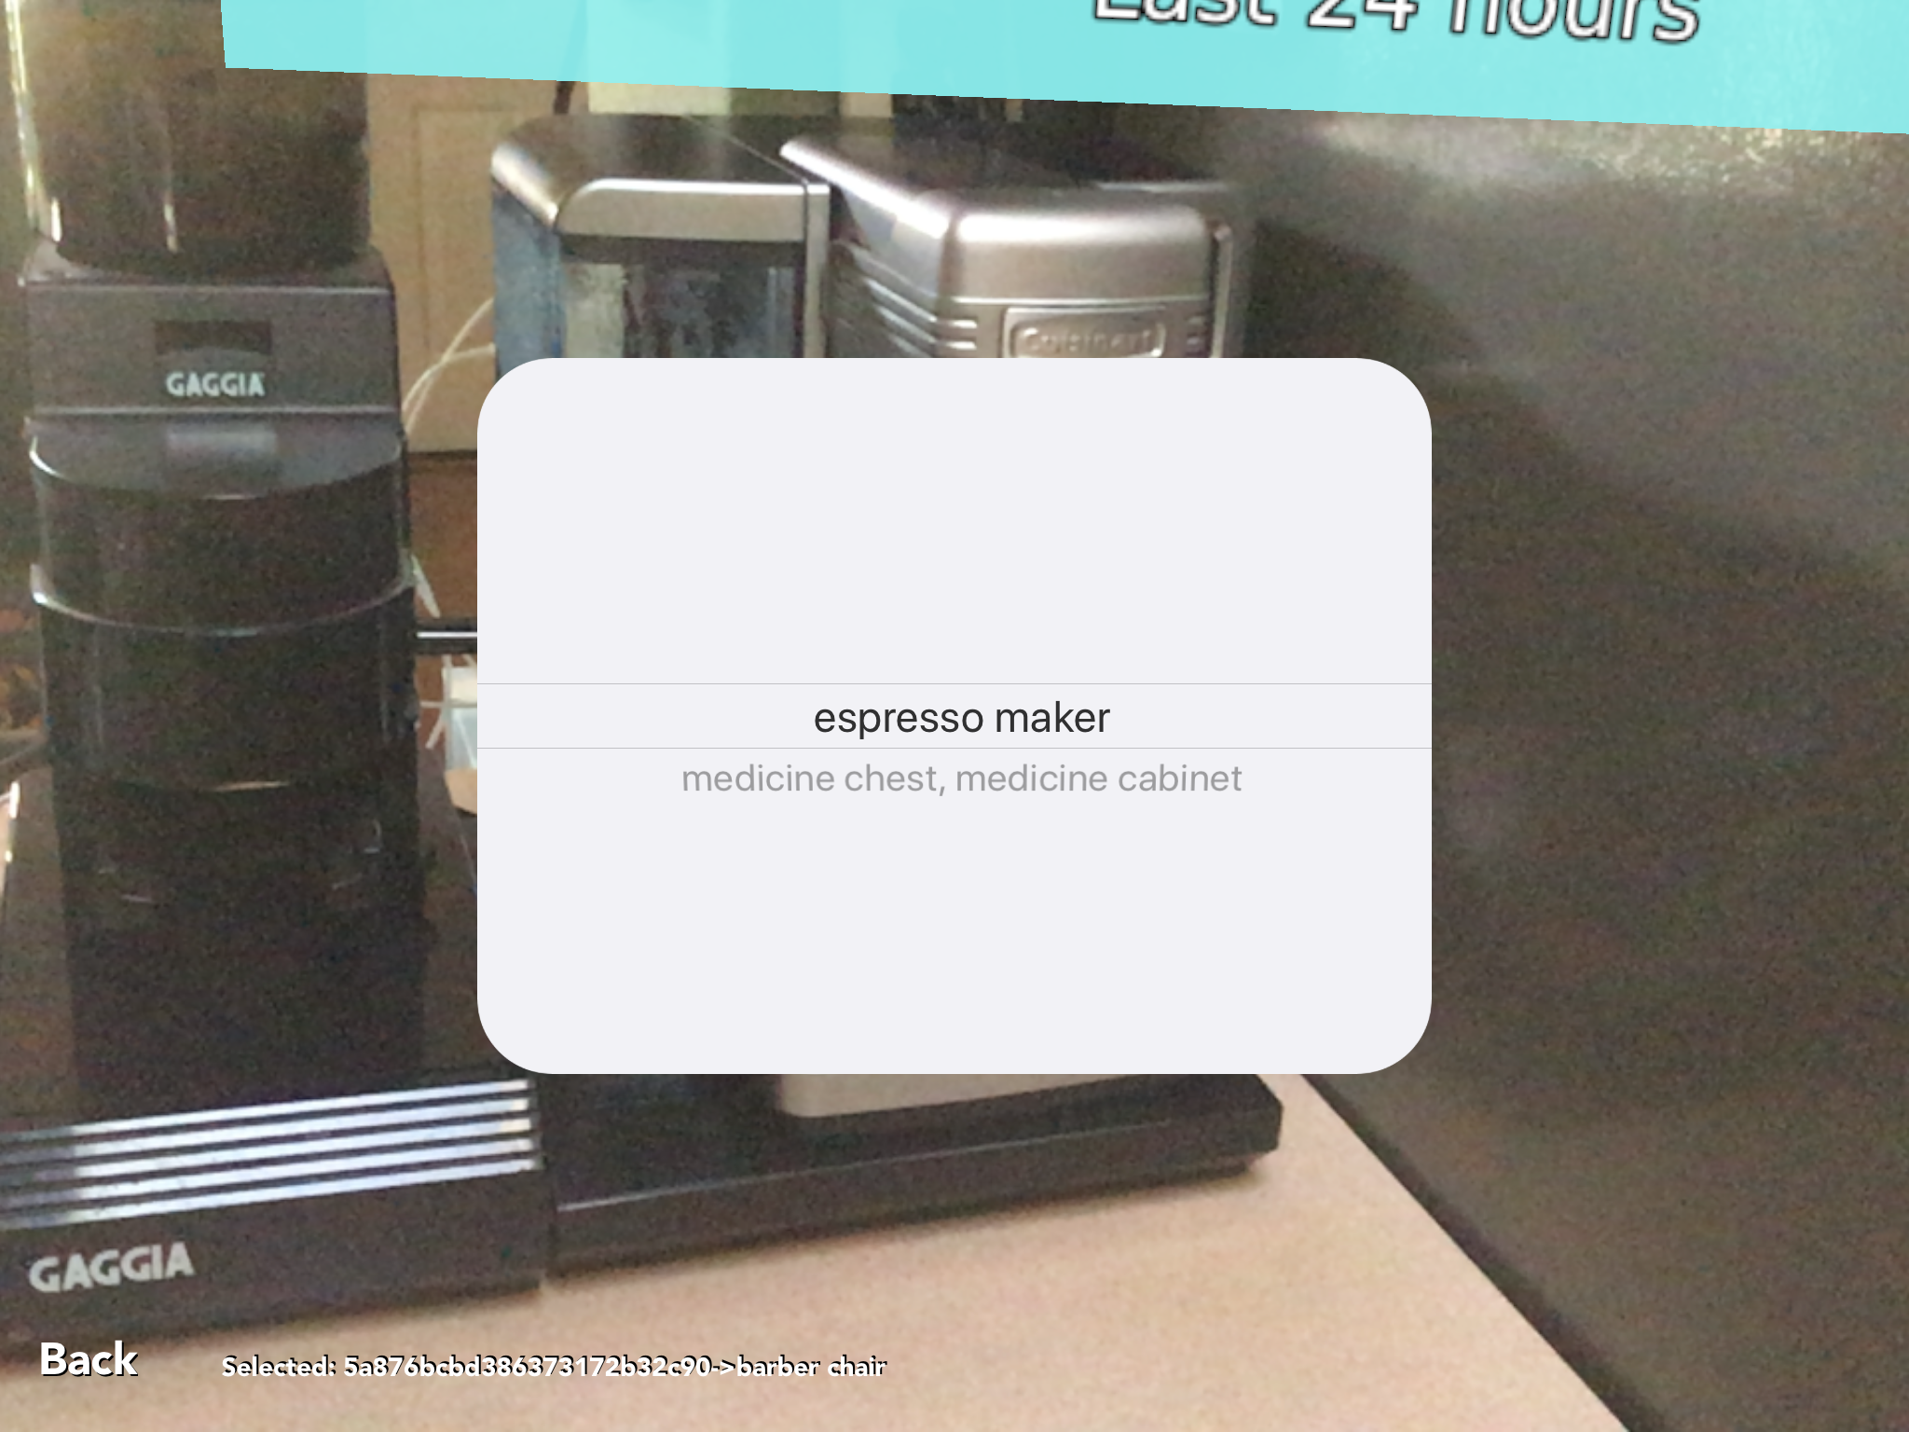
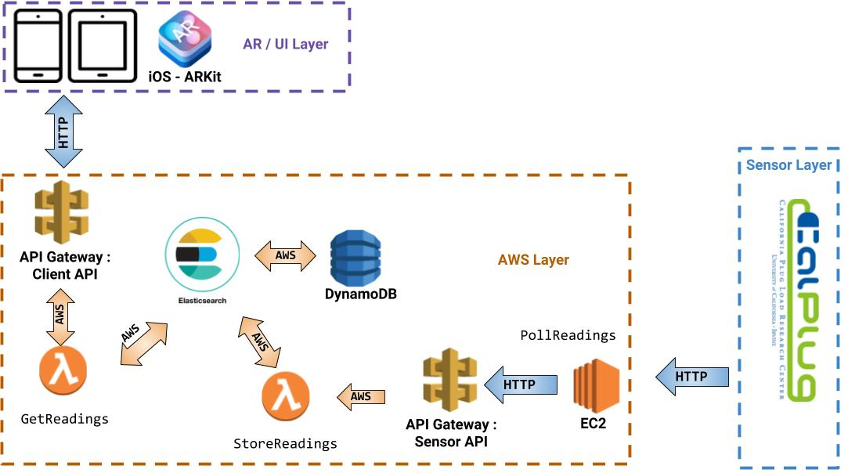
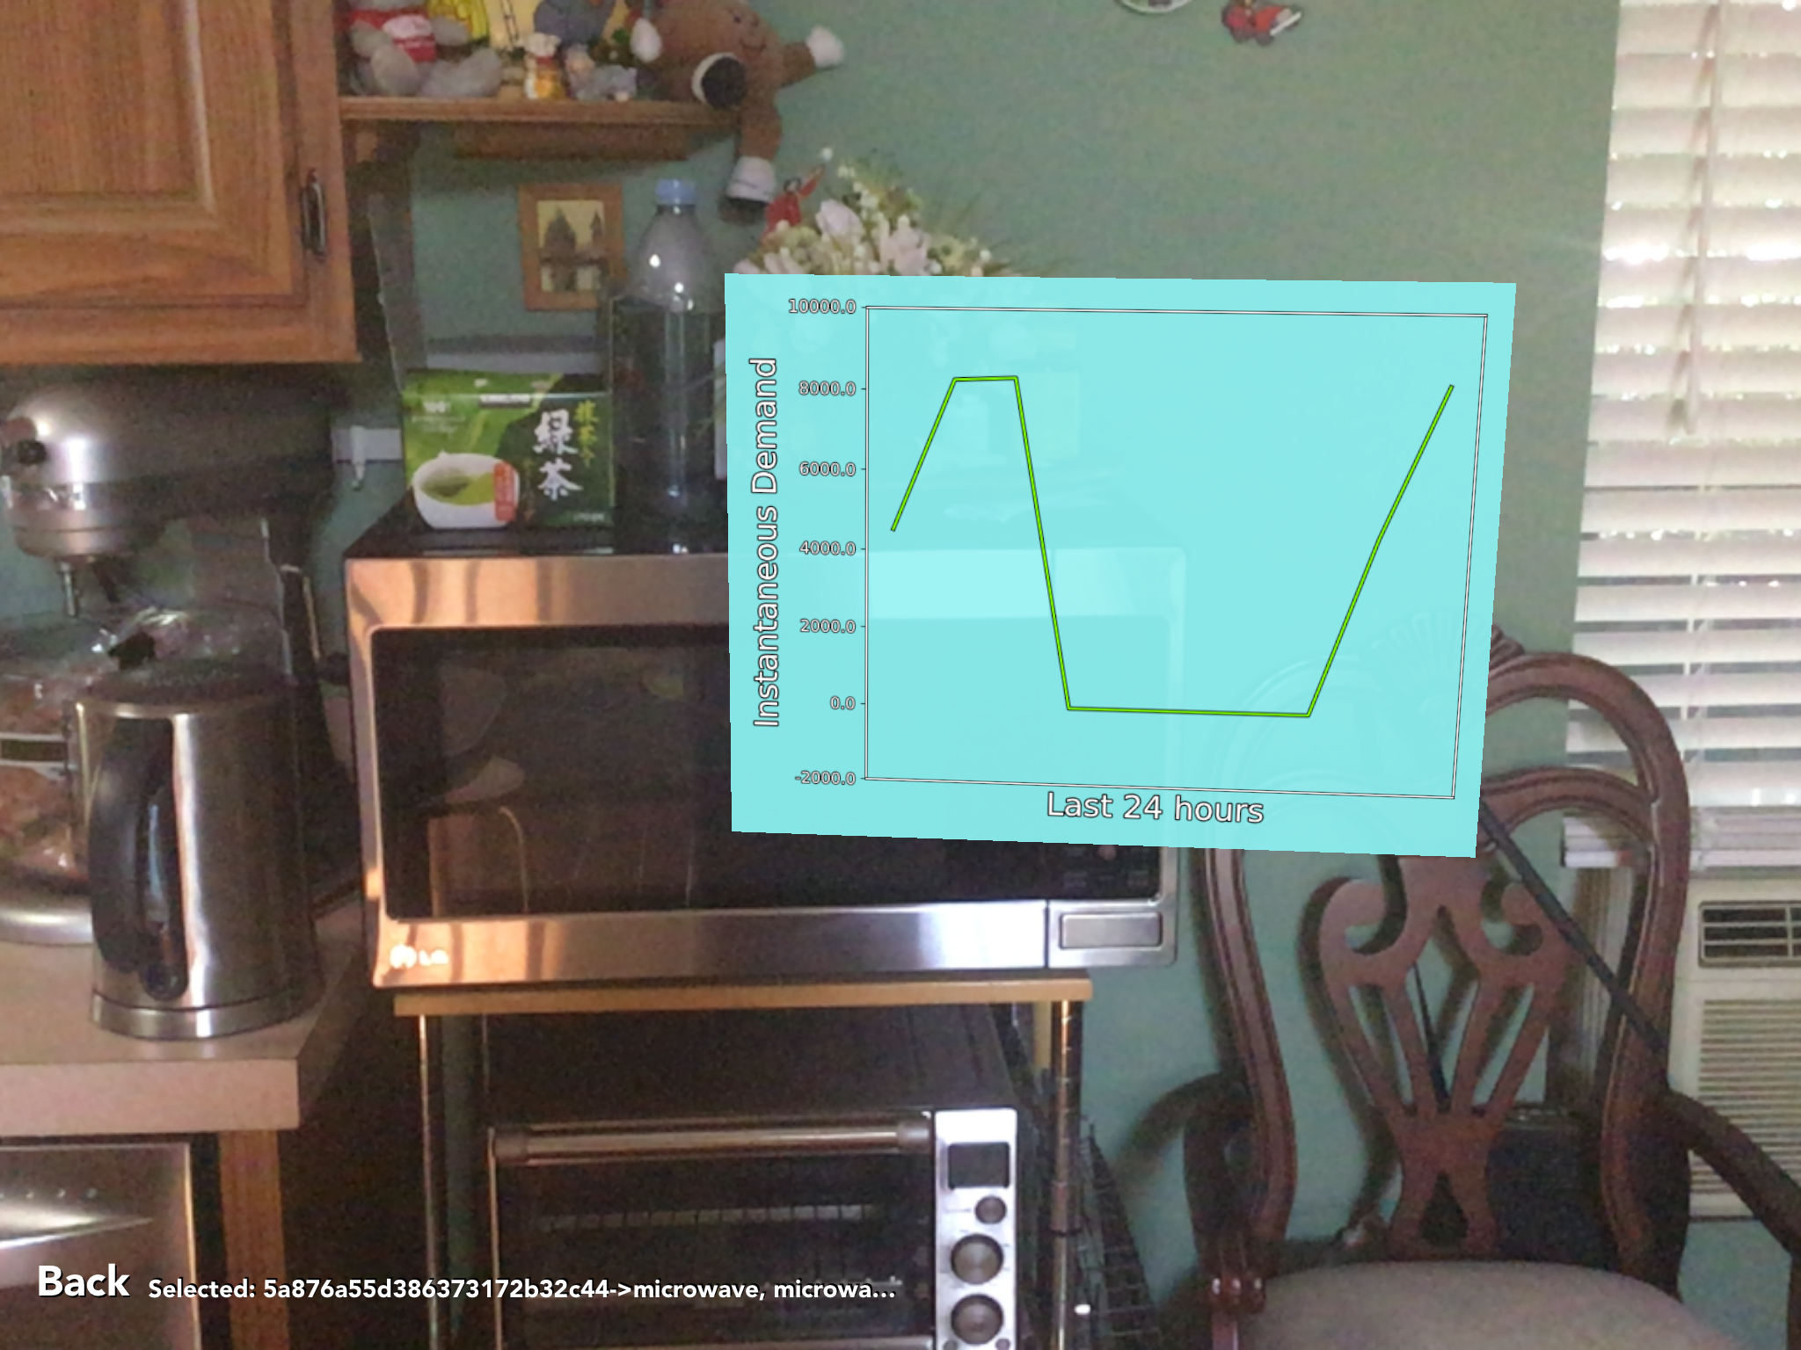
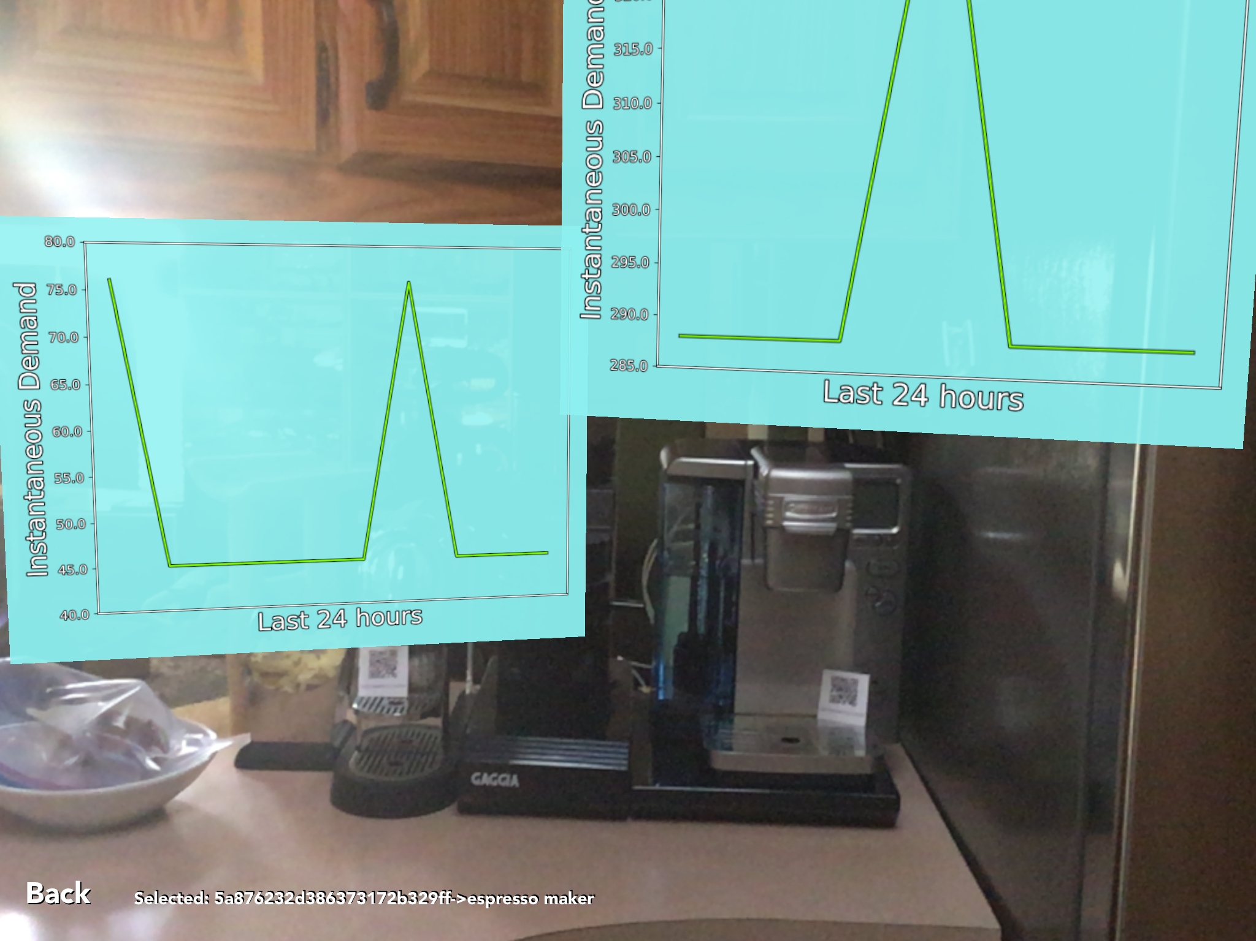



Percept: A Novel Energy Visualizer Tool Team Members: Nikita Tsvetkov, Viet Ly, Kim Phan Truong Faculty Mentors: Sergio Gago, Joy Pixley, Michael Klopfer & Professor G.P. Li (CalPlug/Calit2)
Summary and Project Specifications
Operational Examples
System Diagram
Our augmented reality system provide visual recognition and data tracking capabilities to recognize and provide different types of data in real time on various objects in industrial environments. In order to replicate the “objects in industrial environments” idea, we use different devices reporting data, such as a smart energy meter that can send its power usage to a database, as our test objects. In order to “train” our application to recognize these objects, we assign each object a unique QR code and record that data for reference. Once the training is finished, the application will be able to handle and transform data into a display next to the object.
Our system should be able to:
Use QR code as a persistent training mechanism when the system learns monitored objects for the first time.
Once trained, be able to use visual object recognition augmented by spatial tracking to identify objects.
After the recognition process, display information from CalPlug’s database associated with each device.
Block Diagram for Example System Implementation
Approach
Approach
We aim to use augmented reality technology that is already available on mobile devices, such as the iPhone and iPad, to create a low barrier-to-entry for new users. Our project will leverage Apple’s ARKit to create an AR experience for viewing industrial sensor data. This experience is convenient, because users will only require an internet connected Apple device in order to view the AR. The ARKit is a new AR framework which allows developers to quickly create AR applications. We chose Apple because of their strict standardization of hardware and their OS.
November 15th- Hash out infrastructure/network of application
December 1st - Begin prototype of application
December 20th - Backend and dummy sensors for data
January 1st - Resolution algorithm for 3-dimensional space maps
January 15th - Finish basic data visualization superimposed on environment
February 1st - Finish proof of concept
February 15th - Finish adding additional features after testing
March 1st - Finish testing and gathering feedback
March 15th - Tweak POC based on feedback
Background
Augmented Reality (AR) is an emerging trend, especially now that many mobile device users will now have access to AR due to new Apple and Android updates and extended operating system features. AR enhances the way we perceive our environment, by overlaying a virtual image on top of different objects. The use of AR for practical inspection applications provides a rapid way to view sensor information to detect problems and keep track of equipment in operation. This can be for both residential, commercial, and industrial applications. The application we designed is a demonstration solution using visual and spatial tracking overlaid with real sensor and summary data. This provides a real-time view to the operational parameters, status and history for equipment. Our intended audience are engineers, managers, and inspectors who are interested in the sensor data produced in industrial environments.
Schedule
Final Comments
Acknowledgements
This work is ongoing and part of several internal Calit2 projects in process. This group’s project is also part of the Calit2/UROP MDP program. For more details, please see: http://srproj.eecs.uci.edu/projects/percept
Notes:
Winter Design Review Poster Format – CalPlug Revised
Format: Use a .pdf version. Set the page size to 24”x36” (2ft x 3ft) and provide a 0.25in boarder around the outside of the poster.
1. Header section – provide title, logo, location of the hardware.
2. List team members – include major (ie. EE, CpE, CSE) and advisors.
3. Goal - goal of the project and system requirements. Include a website if any, or design challenge site.
4. Background – overview of system design. --Decompose the system into subsystems, provide drawings, photographs and experiments if any.
5. Team organization -- present the organization chart, with majors of participants.
-Identify subsystem teams and team leads, explain design trade-off are managed.
6. Subsystem presentations -- describe each subsystem design.
-- Goal, Assembly drawings, Reports, Parts drawings, Purchase parts list, Cost.
7. Parts List and Budget (Bill of Material) and Manufacturing Plan
-- Provide list of assemblies, list of machined parts and the list of purchase parts, and the total estimated cost. Outline a manufacturing process and estimate its cost per finished product.
8. Describe the Results, Innovation and Business Opportunity
-- Identify the feature or features that distinguish this product from the competition. Describe the target market, its size and location, and estimate a sales price and volume.
9. Plan – describe the plan and schedule for the next phase. Include website address and contact information for those seeking more about the project.
10. Summary and Team Photo.
1

